Slide 1
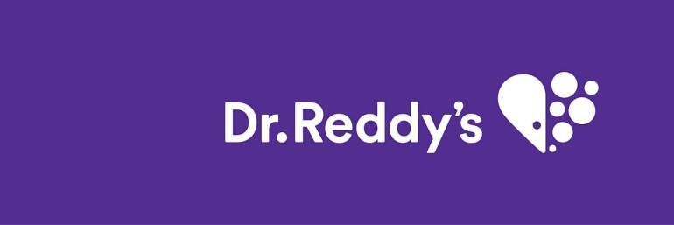
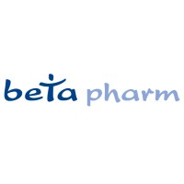
DR reddy’s acquisition of betapharm
“Acquisition that could’ve changed Pharmacy”

Slide 2
MERGER and ACQUISITION [ M&A ]
Mergers and acquisitions (M&A) is a general term that describes the consolidation of companies or assets through various types of financial transactions, including mergers, acquisitions, consolidations, tender offers, purchase of assets, and management acquisitions.
“Mergers” in simple terms is in which two companies form a new legal entity under a common corporate name.​
“Acquisition” is a purchase in which one company buys most or all of another company's shares to gain control of that company.
Example we are going to study of “Dr Reddy’s acquisition of Betapharm” is one of the best examples for Cross Border as well as Horizontal Acquisition.

Slide 3

Case Study: Dr. Reddy's Laboratories
Dr. Reddy's Laboratories is an Indian multinational pharmaceutical company located in Hyderabad, Telangana, India.
Founded: 1984
Founder: Kallam Anji Reddy
Revenue: 17,460 crores INR (US$2.3 billion, 2020)
Market Cap: $714.61Billion
Ranked 42 in top 500 Indian Companies.
13th in the world in terms of value and 4th in the world in terms of volume

Slide 4
Case Study: betapharm
betapharm Arzneimittel GmbH is a German national pharmaceutical company located in Ausburg, Germany.
Founded: 1993
Revenue: US$375 million, 2006
National market

Slide 5
ACQUISITION STUDY
Multinational Indian Dr. Reddy's Laboratories acquires fourth largest generic pharmaceutical company in Germany, betapharm Arzneimittel GmbH
Acquisition Transaction: $560 Million
Acquisition took place in February, 2006
The acquisition gave DRL access to the German generic drugs market, the second-largest generic drugs market in the world, as well as help DRL leverage the strong marketing and distribution channels of betapharm in Germany.
Six years later, the valuation of betapharm in the company’s balance sheet was just $108 million, a 75% fall.

Slide 6
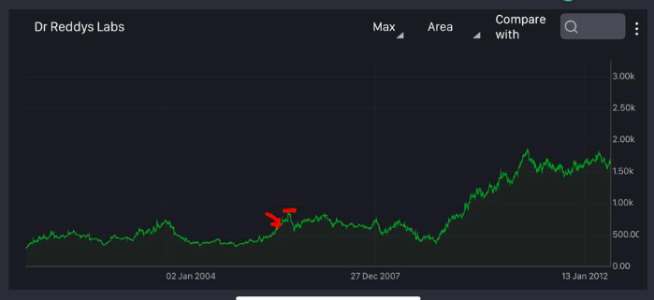
ACQUISITION STUDY
As visible in graph after acquisition Stock Price increased by Rs.200
Then remained stagnant and then a big dip.

Slide 7
OPERATING SYNERGY AND FINANCIAL SYNERGY
Operating synergies allow firms to increase their operating income from existing assets, increase growth or both.
It includes economies of scale, increasing pricing power and higher growth potential.
Operating synergies can affect the operations of the combined firm
This influences the margins and returns, and through these the value of the firms involved in the merger or acquisition
Financial synergies are more focused and include tax benefits, diversification, a higher debt capacity and uses for excess cash.
A combination of a firm with excess cash and a firm with high-return projects can yield a higher value for the combined firm
Debt capacity can increase when two firms combine, their earnings and cash flows may become more stable and predictable.
Diversification: In most publicly traded firms, investors can diversify at far lower cost and with more ease than the firm itself

Slide 8
Synergies in DRL-Betapharm case
The synergies from the acquisition were expected to benefit both DRL and Betapharm.
Through this acquisition DRL could get immediate access to the second-largest generic market in the world, Germany. The acquisition was expected to help DRL gain a strategic presence in the European market.
It was also expected to help DRL realize its ambition of becoming a US$1 billion mid-size global pharmaceutical company by 2008.
Betapharm was expected to benefit in a way that it would be able to add more products to its portfolio and faster rate in Germany. Besides, the acquisition would help it to utilize DRL's global product development and marketing infrastructure to expand its reach in the European market.

Slide 9
Events succeeding the acquisition
Though DRL was not the highest bidder, it clinched the deal largely due to the perceived synergies between the two companies.
However, some analysts viewed it as a mistake arguing that DRL had paid too much for the acquisition as the value of the acquisition was estimated to be more than three times the annual sales of Betapharm.
Germany witnessed the Economic Optimisation of Pharmaceutical Care Act (AVWG) in May 2006. Early signs of trouble were already visible in the firm by then.
The act, while it was meant to increase the scope for the use of generic drugs, affected the margins of Betapharm since it also put some price caps in place.
Reportedly DRL had sacked its earlier plans for more acquisitions in Europe after the Betapharm acquisition.

Slide 10
Subsequent Performance
Dr Reddy's share price shot up by 9.3% to close at Rs 1,281 on February 16, 2006, when it announced the $560 million Betapharm deal. Shares were trading higher at Rs 1,600 in early May.
In the first quarter, the pricing environment turned a little negative for the company since the German government had reduced the prices of drugs by 10-20 % Consequently, the returns were also on the lower side in Sep 2006.
By the last quarter of 2007, Betapharm (DRL’s Subsidiary), had returned to its usual sales at $51 million. Surprisingly, the lower selling, general & administrative (SGA) expenses led to a better operating margin.

Slide 11
CROSS BORDER ACQUISITION
Cross-Border Acquisition is when one company acquires a company that is based on a different country. Cross-border M&A can help companies to expand their operations around the world without having to start from the ground up. Rather take help of experience of the foreign country company, in its country.
There are two main types of Cross Border M&As: Inbound and Outbound Inbound M&As: In this process foreign company mergers with or acquires an Indian company. Outbound M&As: In this process an Indian company merger with or acquires a foreign company.
A.) The state where the origin of the companies that make an acquisition (the acquiring company) in other countries: – “Home Country”. B.) A country where the target company is situated refers to as the “Host Country”.
In our case “Home Country” is India , “Host Country” is Germany. And the type of Cross Border M&A is Outbound.
In our case Dr Reddy’s → India Betapharm → Germany

Slide 12
HORIZONTAL ACQUISITION
Horizontal Acquisition is when one company acquires another company in the same industry and works at the same production stage. The new combined entity will be in a better competitive position due to increased market share or scalability than the standalone companies combined to form it.
During a horizontal acquisition, a company can expand its production of products, but it doesn't mean a pivot for the company. Horizontal acquisitions expand the capacity of the acquirer, but the basic business operations remain the same, unlike an acquisition that creates a wholly different company.
In our case Dr Reddy’s & Betapharm both →Pharmaceuticals

Slide 13
COST OF EQUITY + COST OF DEBT
Every business needs capital to operate successfully. Capital is the money a business—whether it's a small business or a large corporation—needs and uses to run its day-to-day operations. Capital may be used to make investments, conduct marketing and research, and pay off debt.
There are two main sources of capital companies rely on—debt and equity: -Debt: Debt capital refers to borrowed funds that must be repaid at a later date. This is any form of growth capital a company raises by taking out loans. These loans may be long-term or short-term such as overdraft protection. -Equity: Because equity capital typically comes from funds invested by shareholders, the cost of equity capital is slightly more complex. Equity funds don't require a business to take out debt which means it doesn't need to be repaid. But there is some degree of return on investment shareholders can reasonably expect based on market performance in general and the volatility of the stock in question.

Slide 14
COST OF EQUITY + COST OF DEBT
In case of Acquisition 100% ownership is transferred to the Buyer hence, Cost of Equity = Transaction amount
The company already had $200 million in cash (about Rs 900 crore). The rest was raised through debt from domestic financial institutions. The debt-equity ratio rose to 1.39 times in March 2006. However, the company went for American depositary receipts the following year, raising Rs 1,000 crore and part-paying the debt raised for Betapharm. The debt-equity ratio then fell to a comfortable 0.59 times.​
Citigroup was the sole arranger and structurer for the financing of this acquisition. ​
HarbourVest Partners​, 3i Private Equity, Indigo Capital LLP were the equity firms that owned betapharm.

Slide 15
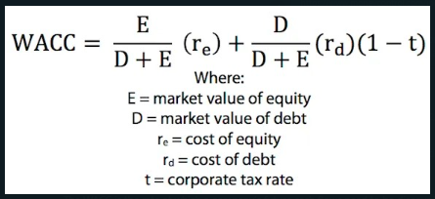
WACC (Weighted Average Capital Cost)
The WACC is the rate at which a company’s future cash flows need to be discounted to arrive at a present value for the business.
It reflects the perceived riskiness of the cash flows. Put simply, if the value of a company equals the present value of its future cash flows, WACC is the rate we use to discount those future cash flows to the present.
Capital structure — a company’s debt and equity mix.

Slide 16
WACC (Weighted Average Capital Cost)
NPV estimated at €550-560mn
DRL has not yet disclosed adequate data on betapharm and hence it is tough to forecast the financials of the combined entity. Hence, our revised financial forecast does not incorporate any impact of betapharm except reduction in financial income from surplus cash. However, with assumptions and available industry data, we have done a quick NPV valuation of betapharm and arrived at a value of €550-560 million (or Rs 380-400 per share) assuming WACC of 12% and a sustainable growth rate of 5%. The payback period is likely to be 6-7 years.

Slide 17
THANK YOU !!
Mentors: Shivam Pandey, Nivn Vinod, Shubham Gupta

